Slide 1
SECURE DATA HIDING IN IMAGE USING STEGANOGRAPHY
CAPSTONE PROJECT
Presented By: Pooja S
Student Name : Pooja S
College Name & Department : Sri Krishna College of Engineering and Technology, Coimbatore – BE CSE(CYBER SECURITY)

Slide 2
OUTLINE
Problem Statement
Technology used
Wow factor
End users
Result
Conclusion
Git-hub Link
Future scope

Slide 3
Problem Statement
In a world where digital privacy is constantly at risk, simply encrypting messages can attract unwanted attention. What if sensitive information could be hidden in plain sight—inside an ordinary image? This project brings steganography to life, allowing users to seamlessly embed and extract hidden messages from images. With an intuitive interface and a strong focus on security, it offers a creative way to communicate covertly without raising suspicion.

Slide 4
Technology used
Programming Language: Python
Graphical User Interface (GUI): Tkinter
Image Processing: Pillow (PIL)
File Handling: OS, filedialog
Encoding Method: LSB Steganography
Error Handling: Tkinter messagebox
Binary Processing: BytesIO

Slide 5
Wow factors
Hide Messages in Plain Sight – Conceal text inside images without altering their appearance.
User-Friendly Interface – Simple, click-based GUI for easy encoding and decoding.
Instant Preview – View selected images before hiding or revealing messages.
No External Dependencies – Works with standard image formats without requiring complex setups.
Secure & Undetectable – Uses LSB steganography, making hidden messages nearly impossible to detect visually.

Slide 6
End users
Cybersecurity Experts – Secure communication and data protection.
Journalists & Activists – Safely share sensitive information.
Military & Intelligence – Covert message transmission.
Forensic Investigators – Extract hidden data for digital investigations.
Privacy-Conscious Users – Hide personal messages from prying eyes.

Slide 7
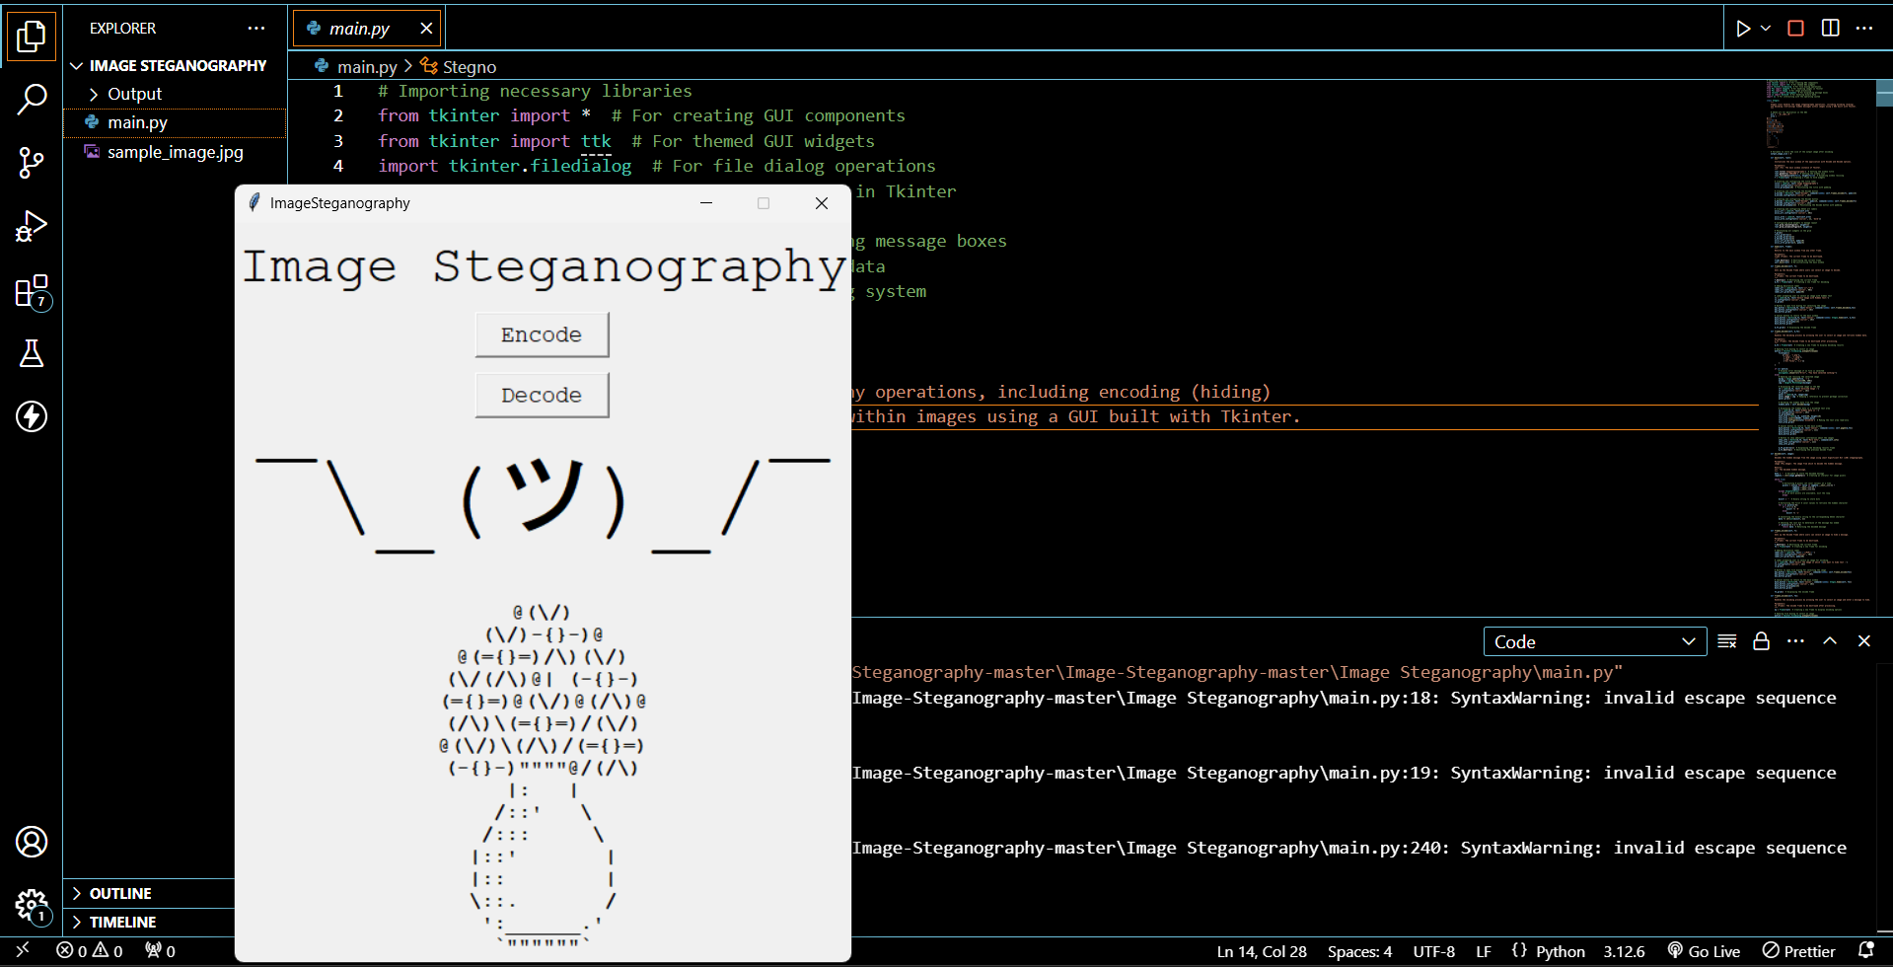
Results

Slide 8
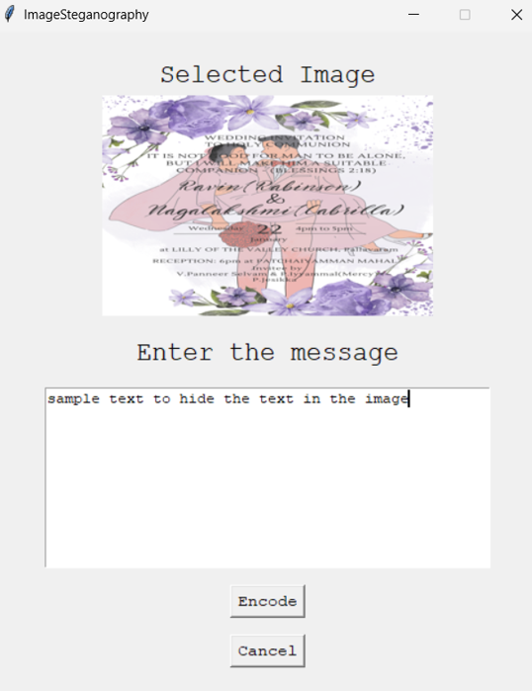

Results

Slide 9
Conclusion
Steganography offers a powerful way to hide messages in plain sight, making communication more secure and discreet.
This project provides a user-friendly tool for encoding and decoding hidden messages in images with just a few clicks.
By leveraging Python, Tkinter, and LSB Steganography, the system ensures efficiency, simplicity, and security.
Future enhancements can include encryption, multiple file format support, and AI-based steganalysis resistance.
Image Steganography is not just a technique—it’s a step toward safer digital communication!

Slide 10
GitHub Link
Link: https://github.com/pooja-skcet/ImageSteganography.git

Slide 11
THANK YOU

